Slide 1
Security and Privacy
Fall 2019
Instructor: Dr. Saeed Samet
School of Computer Science
University of Windsor

Slide 2
Chapter 4
Program Security

Slide 3
Chapter Outline
Terminology
Secure Programs
Types of Flaws
Classic Errors
Viruses and Other Malicious Code
Trapdoors
Controls Against Program Threats

Slide 4
Terminology
Fault
An incorrect step, command, process, or data definition in a computer program, lead by an Error
The cause of problem
An inside view of the system, as seen by the eyes of the developers
Failure
A departure from the system’s required behavior
The effect of the faults
An outside view: a problem that the user sees

Slide 5
Secure Programs
When do we say a program or software is Secure?
Name the characteristics of software that contribute to its overall security
The importance of the characteristics depends on who is analyzing the software
Can also be influenced by someone’s general perspective on software quality
Quantity and types of faults for evidence of a product’s quality

Slide 6
Secure Programs (cont.)
Penetrate and Patch
Searching for faults and repairing them by analysts
Patch efforts are largely useless, making the system less secure rather than more secure because they frequently introduced new faults
A narrow focus on the fault itself and not on its context
The analysts paid attention to the immediate cause of the failure and not to the underlying design or requirements faults
The fault often had nonobvious side effects in places other than the immediate area of the fault.
Fixing one problem often caused a failure somewhere else, or the patch addressed the problem in only one place, not in other related places.
The fault could not be fixed properly because system functionality or performance would suffer as a consequence.

Slide 7
Secure Programs (cont.)
Unexpected Behavior (Program Security Flaw)
Compare the requirements with the behavior
Software behaves as its designers intended or users expected
It is based on Flaws and Vulnerabilities
Flaw could be a fault or a failure
Vulnerability usually describes a class of flaws
There is no map from these two to Fault and Failure
Flaws categories
Inadvertent human errors
Malicious, intentionally induced flaws

Slide 8
Types of Flaws
Intentional
Malicious
Non-malicious
Inadvertent
Validation error (incomplete or inconsistent): permission checks
Domain error: controlled access to data
Serialization and aliasing: program flow order
Inadequate identification and authentication: basis for authorization
Boundary condition violation: failure on first or last case
Other exploitable logic errors

Slide 9
Classic Errors
Buffer Overflows
Trying to pour two liters of water into a one-liter pitcher: Some water is going to spill out and make a mess
Example
C language:
char sample[10];
sample[i] = 'B';
or
for (i=0; i<=9; i++)
sample[i] = 'A';
sample[10] = 'B';

Slide 10
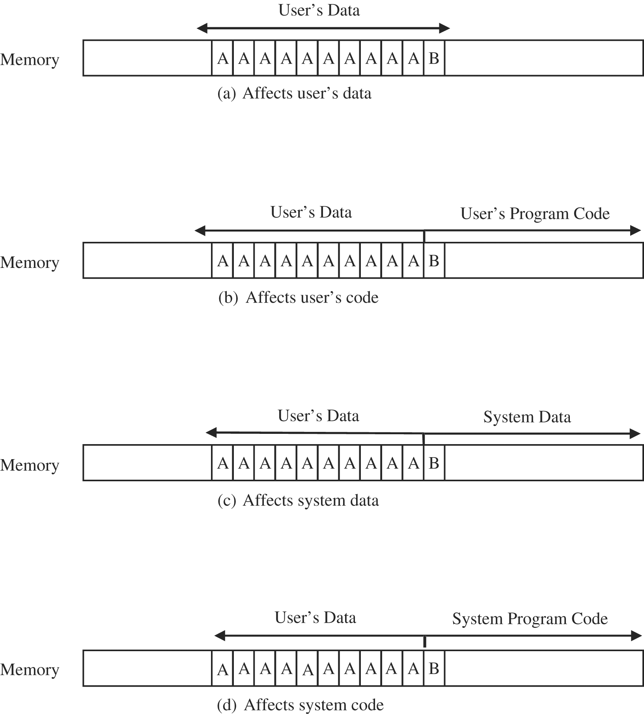
Classic Errors (cont.)

Slide 11
Classic Errors (cont.)
Incomplete Mediation
Occurs when the application accepts incorrect data from user
http://www.somesite.com/subpage/userinput.asp?parm1=(808)555-1212&parm2=2009Jan17
A user can send arbitrary (unmediated) values to the server

Slide 12
Classic Errors (cont.)
Time-of-Check to Time-of-Use Errors
Serialization or synchronization flaw
Caused by ineffective access control
Example
A person buys a sculpture that costs $100
The buyer counts five $20 bills in front of the seller, and lays them on the table
Then the seller turns around to write a receipt
The buyer takes back one $20 bill
When the seller turns around, the buyer hands over the stack of bills, takes the receipt, and leaves with the sculpture
Between the time the security was checked (counting the bills) and the access (exchanging the sculpture for the bills), a condition changed
What was checked is no longer valid when the object is accessed

Slide 13
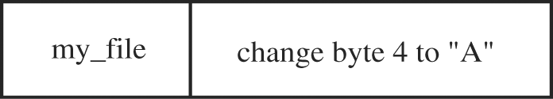
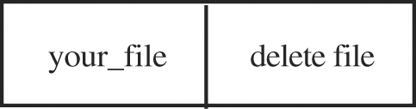
Classic Errors (cont.)
Time-of-Check to Time-of-Use Errors (cont.)
Example
A request to access a file for an authorized modification
The request is changed by the user

Slide 14
Viruses and Other Malicious Code
Unanticipated or undesired effects in programs or program parts, caused by an agent intent on damage
A program that can replicate itself and pass on malicious code to other non-malicious programs by modifying them
Work done by a program is invisible to users
When was the last time you saw a bit?
Do you know in what form a document file is stored?
If you know a document resides somewhere on a disk, can you find it?
Can you tell if a game program does anything in addition to its expected interaction with you?
Which files are modified by a word processor when you create a document?
Which programs execute when you start your computer or open a web page?

Slide 15
Viruses and Other Malicious Code (cont.)
Virus
Transient
It has a life that depends on the life of its host
The virus runs when its attached program executes and terminates when its attached program ends
Resident
It locates itself in memory; then it can remain active or be activated as a stand-alone program, even after its attached program ends.
Trojan horse
It has a second, nonobvious malicious effect.
Example
A login script that solicits a user’s identification and password, passes the identification information on to the rest of the system for login processing, but also retains a copy of the information for later, malicious use

Slide 16
Viruses and Other Malicious Code (cont.)
Logic Bomb
A class of malicious code that detonates when a specified condition occurs
A time bomb is a logic bomb whose trigger is a time or date
Trapdoor or Backdoor
A feature in a program by which someone can access the program other than by the obvious, direct call, perhaps with special privileges
Example
An automated bank teller program might allow anyone entering the number 990099 on the keypad to process the log of everyone’s transactions at that machine
The trapdoor could be intentional, for maintenance purposes
It could be an illicit way to wipe out any record of a crime.

Slide 17
Viruses and Other Malicious Code (cont.)
Worm
A program that spreads copies of itself through a network
The primary difference between a worm and a virus is that a worm operates through networks, and a virus can spread through any medium
Additionally, the worm spreads copies of itself as a stand-alone program, whereas the virus spreads copies of itself as a program that attaches to or embeds in other programs
Rabbit
a virus or worm that self-replicates without bound, with the intention of exhausting some computing resource

Slide 18
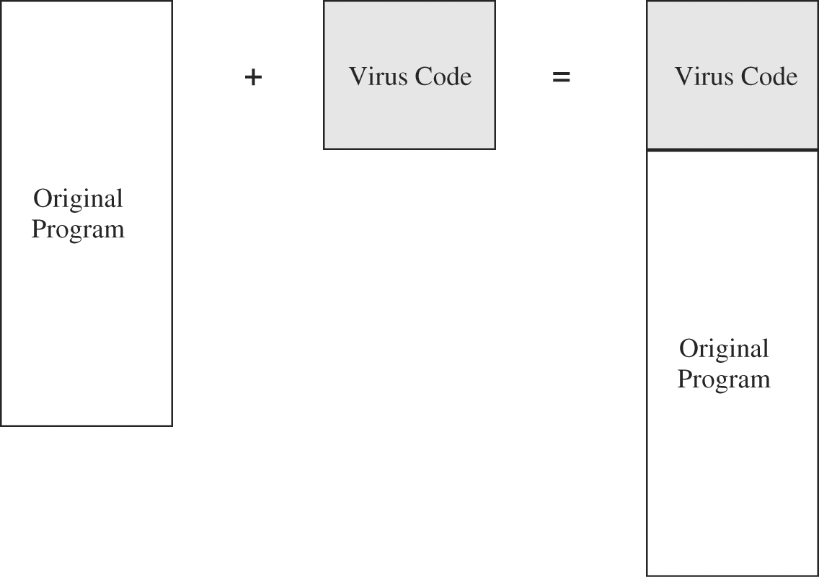
Viruses and Other Malicious Code (cont.)
Appended Viruses
A virus code could be a program on the distribution medium
When program executed, the virus could install itself on a permanent storage medium, such as hard disk
A newer way: as an attachment to an e-mail message, activated when is opened

Slide 19
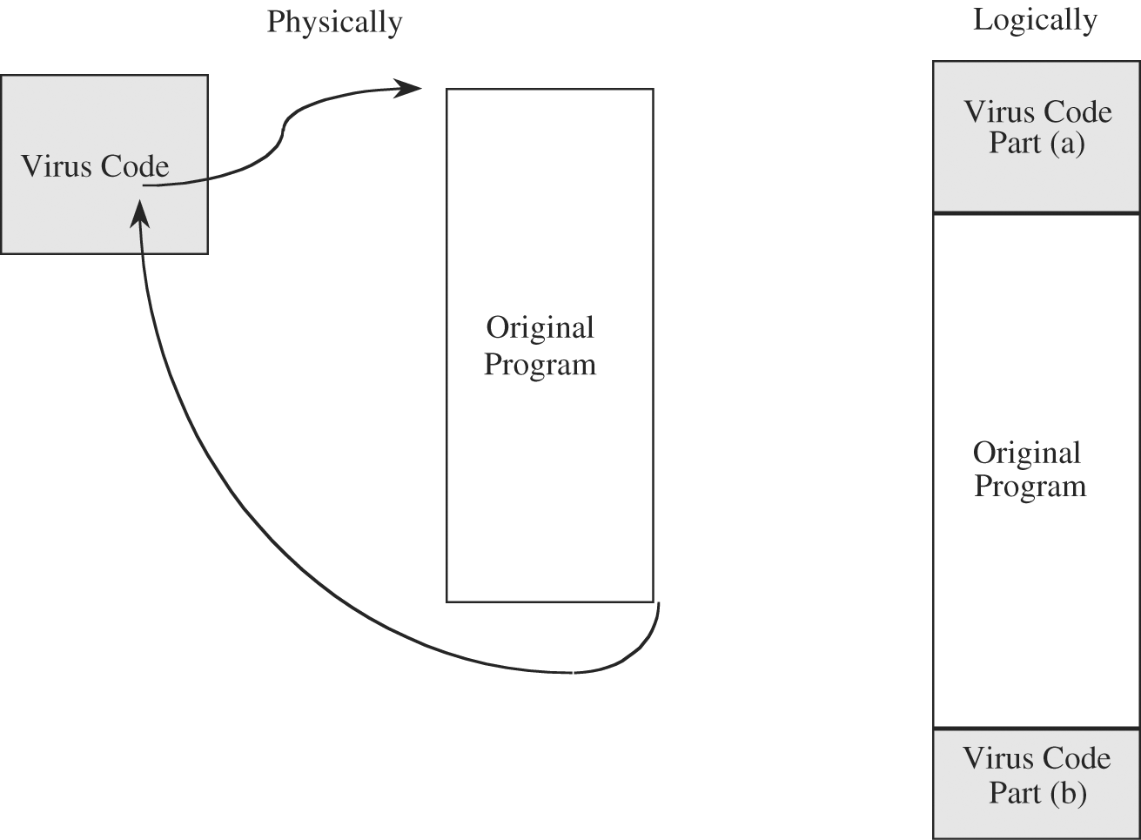
Viruses and Other Malicious Code (cont.)
Viruses that Surround a Program
Viruses that run the original program but have control before and after its execution, for example:
Attach itself to the program that constructs the listing of files on the disk
After the listing program has generated the listing, the virus could eliminate its entry from the listing and falsify space counts

Slide 20
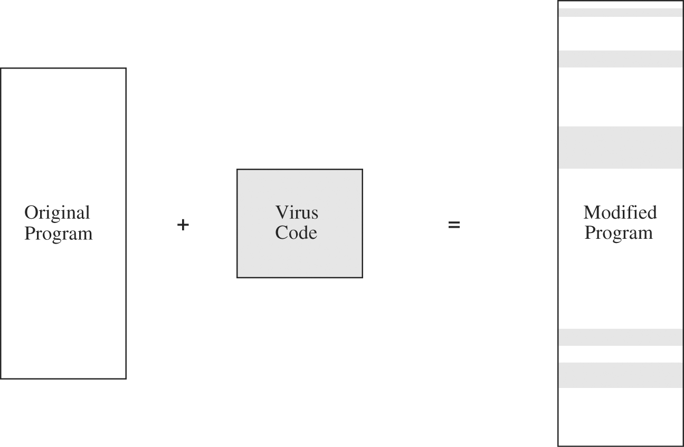
Viruses and Other Malicious Code (cont.)
Integrated Viruses and Replacements
The virus replaces some of its target, integrating itself into the original code of the target
The virus writer has to know the exact structure of the original program to know where to insert which pieces of the virus

Slide 21
Viruses and Other Malicious Code (cont.)
Document Viruses
One popular virus type is called the document virus
It is implemented within a formatted document, such as a written document, a database, a slide presentation, a picture, or a spreadsheet
These documents are highly structured files that contain both data (words or numbers) and commands (such as formulas, formatting controls, links)
The commands are part of a rich programming language, including macros, variables and procedures, file accesses, and even system calls
The writer of a document virus uses any of the features of the programming language to perform malicious actions

Slide 22
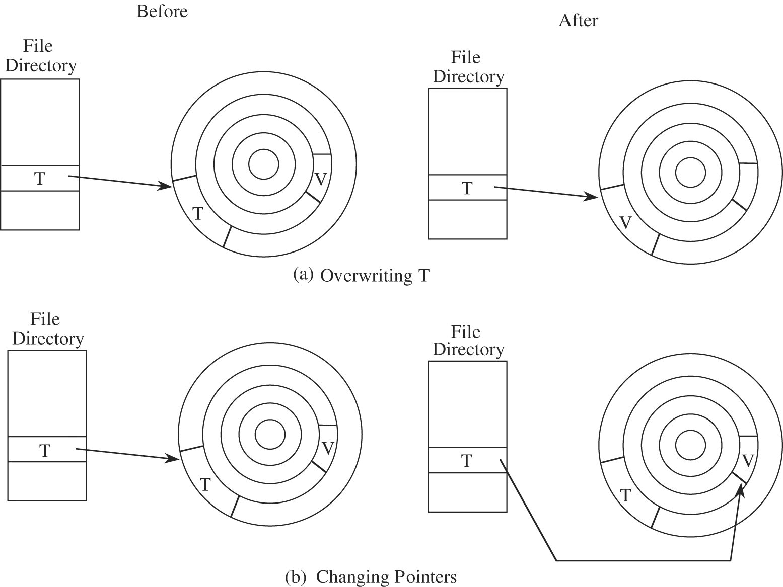
Viruses and Other Malicious Code (cont.)
How Viruses Gain Control
The virus either has to seem to be T, saying effectively “I am T” or the virus has to push T out of the way and become a substitute for T, saying effectively “Call me instead of T

Slide 23
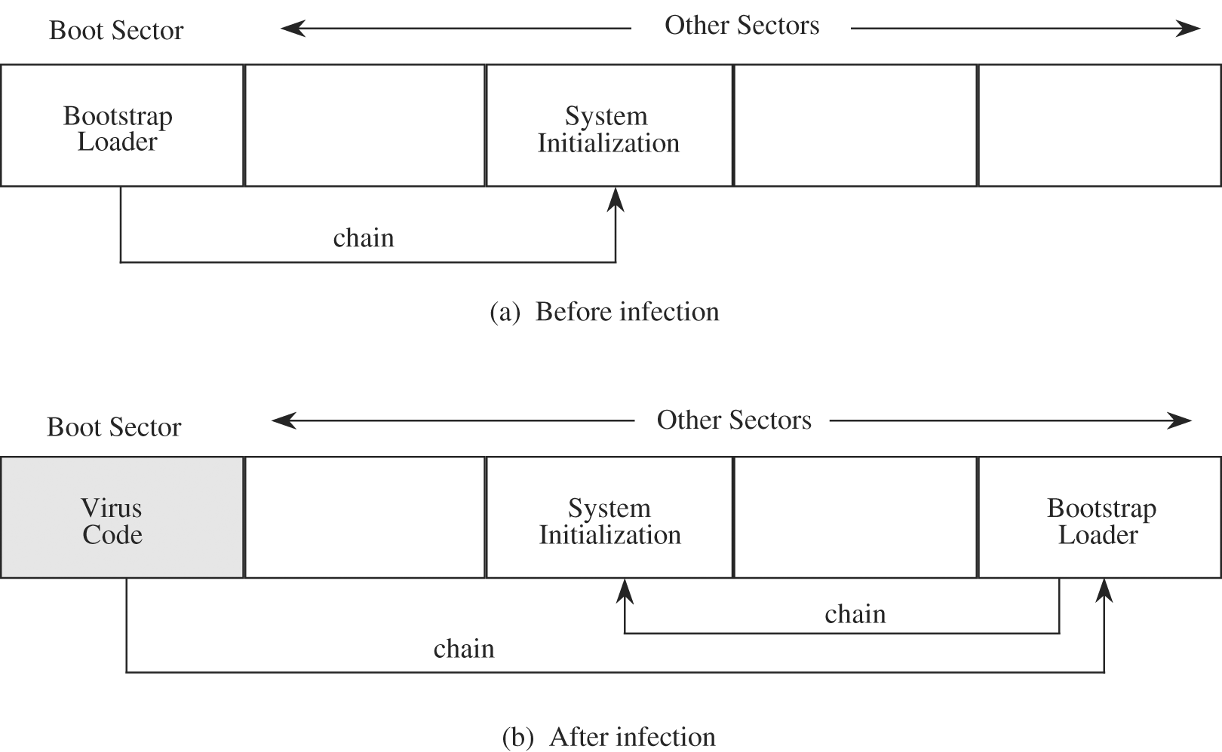
Viruses and Other Malicious Code (cont.)
Where viruses will reside
One-Time Execution
The majority of viruses today execute only once, spreading their infection and causing their effect in that one execution. A virus often arrives as an e-mail attachment of a document virus
Boot Sector Viruses

Slide 24
Viruses and Other Malicious Code (cont.)
Where viruses will reside (cont.)
Memory-Resident Viruses
Resident code is activated many times while the machine is running
Each time the resident code runs, the virus does too
Other Homes for Viruses
Macro in some applications
In macros user can record a series of commands and repeat them with one invocation
Such programs also provide a startup macro that is executed every time the application is executed
Libraries
They are used by many programs, thus the code in them will have a broad effect
They are often shared among users and transmitted from one user to another, a practice that spreads the infection

Slide 25
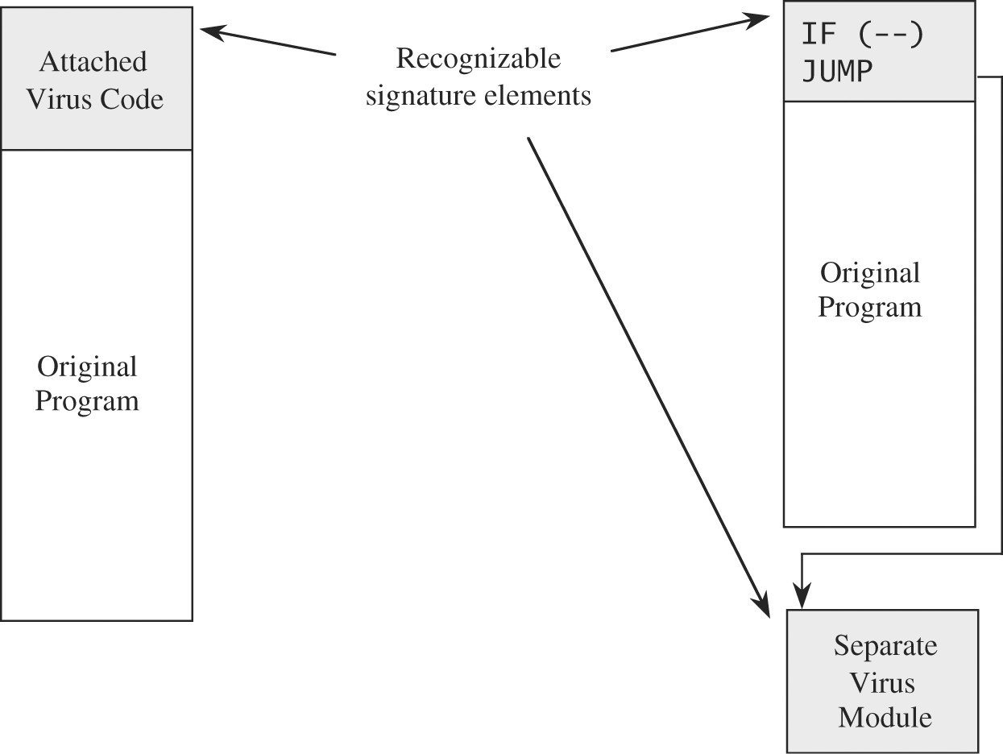
Viruses and Other Malicious Code (cont.)
Virus Signature
Every virus must be stored somewhere, and executes in a particular way
Virus Scanner
Uses signature to detect and possibly remove viruses
Storage Patterns

Slide 26
Viruses and Other Malicious Code (cont.)
Techniques for building a safe community for electronic contact
Use only commercial software acquired from reliable, well-established vendors
Test all new software on an isolated computer and look for unexpected behavior
Open attachments only when you know them to be safe. Certainly, an attachment from an unknown source is of questionable safety. You might also distrust an attachment from a known source but with a peculiar message.

Slide 27
Viruses and Other Malicious Code (cont.)
Techniques for building a safe community for electronic contact (cont.)
Make a recoverable system image and store it safely. You must keep the image write-protected during reboot
Make and retain backup copies of executable system files and important data files
Use virus detectors regularly and update them daily. Several scanners are better than one because one may detect the viruses that others miss. Keep your detector’s signature file up to date.

Slide 28
Trapdoors
An undocumented entry point to a module.
Developers insert trapdoors during code development
To test the module
To provide hooks by which to connect future modifications or enhancements
To allow access if the module should fail in the future
To allow a programmer access to a program once it is placed in production.
Useful Trapdoors (say for audits purposes)
Must be documented
Access to them should be strongly controlled
Must be designed and used with full understanding of the potential consequences

Slide 29
Controls Against Program Threats
Types of Controls
Developmental
Software Development
Specify the system
Design the system
Implement the system
Test the system
Review the system at various stages
Document the system
Manage the system
Maintain the system
Operating System
Administrative

Slide 30
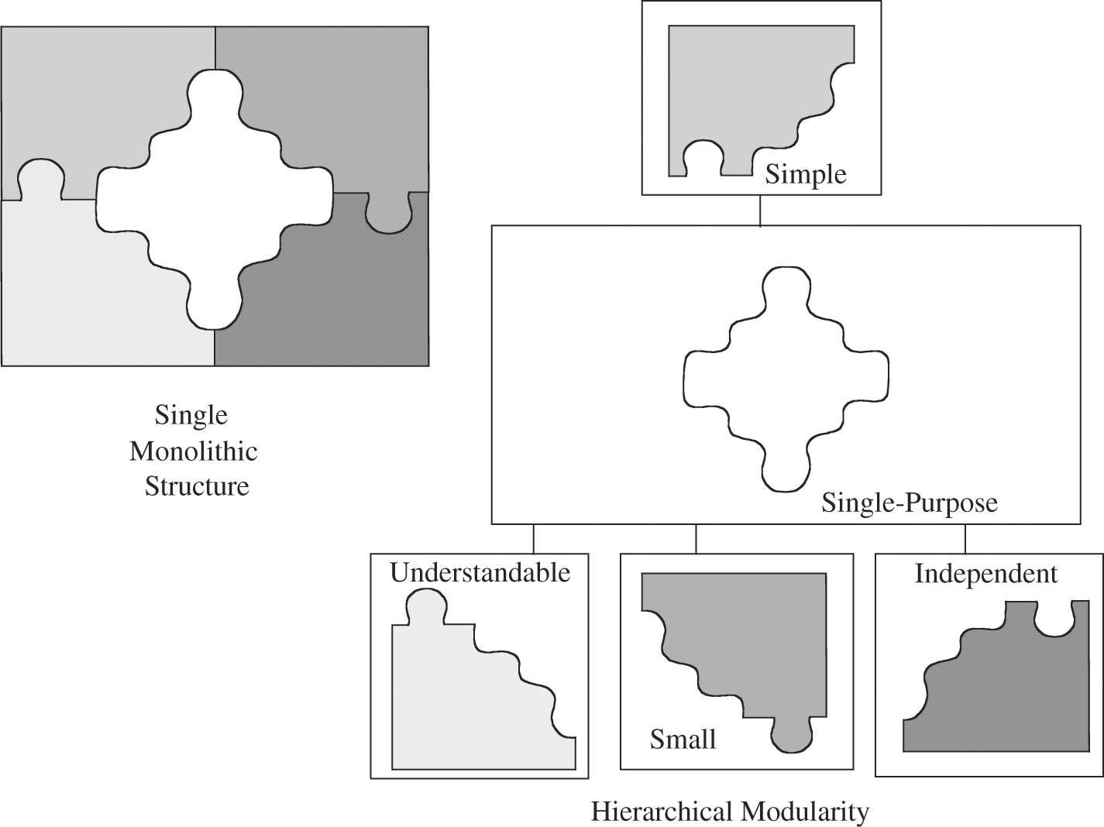
Controls Against Program Threats
Software Development
Modularity
Create a design or code in small, self-contained units, called components or modules
High cohesion
All the elements of a
component have a logical
and functional reason for
being there
Low coupling
loosely coupled components
are free from unwitting interference
from other components

Slide 31
Controls Against Program Threats
Software Development (cont.)
Encapsulation
Easier to trace a problem
Easier to maintain the system
Easier to see where vulnerabilities may lie
Information Hiding
Each component hides its precise implementation or some other design decision from the others (Black Box)
When a change is needed, the overall design can remain intact while only the necessary changes are made to particular components

Slide 32
Controls Against Program Threats
Software Development (cont.)
Security practices
Mutual Suspicion
A calling program cannot trust its called sub-procedures to be correct, and
A called sub-procedure cannot trust its calling program to be correct.
Each protects its interface data so that the other has only limited access
Confinement
A confined program is strictly limited in what system resources it can access
If a program is not trustworthy, the data it can access are strictly limited
Genetic Diversity
It is risky having many components of a system come from one source

Slide 33
Controls Against Program Threats
Software Development (cont.)
Other techniques (cont.)
Hazard analysis
Developing hazard lists, as well as procedures for exploring “what if” scenarios to trigger consideration of nonobvious hazards
Testing
Black-box testing
Clear-box testing (White-box testing)
Testing types
Unit testing
Integration testing
Function test
Performance test
Acceptance test
Regression testing
Penetration testing

